Slide 1
Namma Yatri - Trips Dashboard Overview
Snapshot of key trip activity and driver earnings on the platform.
Completed Trips: 5,951
Searches: 12,000
Estimates Given: 66,643
Quotes Provided: 6,218
Driver Earnings: ₹9 Million

Slide 2
Distance Analysis by Duration
Daily Distance Trends
Spikes and Dips
Use Cases
Distance ranges between 6,000 to 7,500 units per day, showing typical commute volumes.
Spikes indicate busier travel days; dips show low demand or external impact.
Analyze weather, holidays, events effects on travel demand.

Slide 3
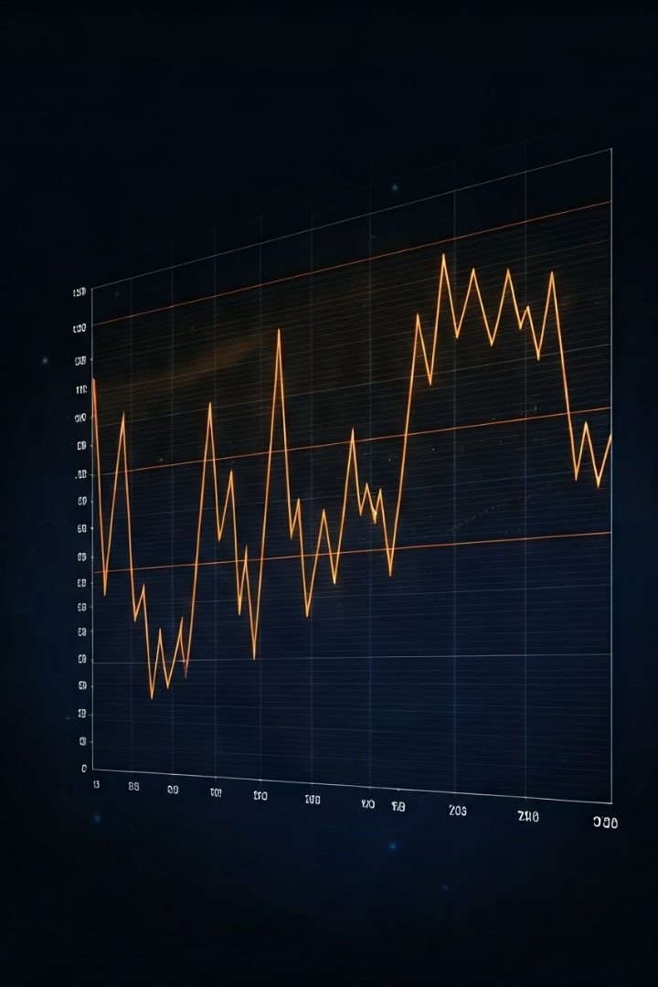
Fare Analysis by Duration
Fare vs Distance
Major Spike on Day 10
Fare trends closely follow distance but with sharper peaks.
Indicates either surge pricing or longer trips on that day.
Revenue Insights
Shows how pricing adapts to rider demand and trip length.

Slide 4

Engagement Funnel - Assembly Level
Assembly
Searches
Estimates
Quotes
Customer Not Cancelled
Anekal
869
430
432
442
Bangalore South
1200
700
680
670
Highlights regional engagement efficiency and user retention.

Slide 5
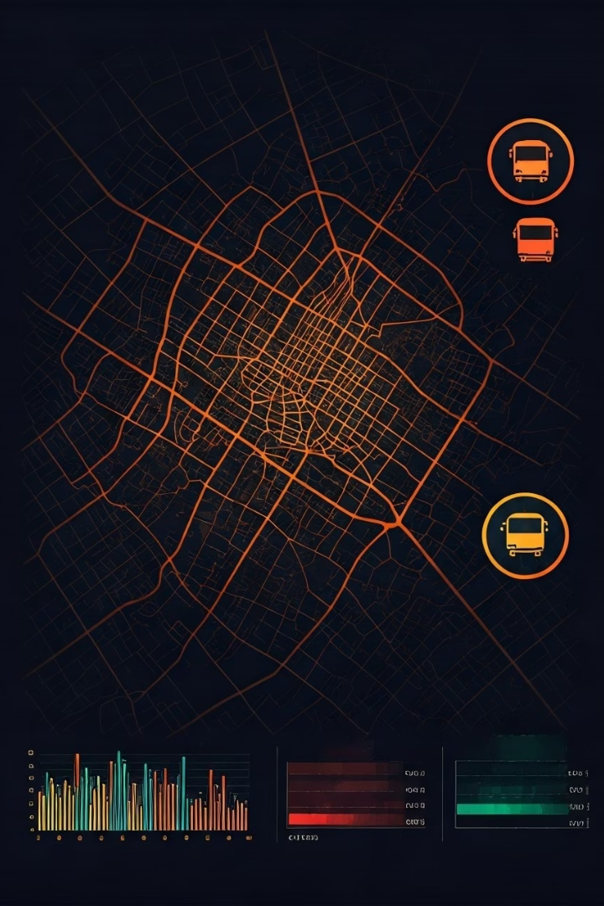
Performance of Top Assemblies
Chickpet
Bommanahalli
Strong search and quote balance indicating healthy supply.
Quotes lower than searches; supply-demand mismatch possible.
Chamrajpet
High engagement; potential for driver allocation optimization.
Prioritize driver deployment and target promotions regionally.

Slide 6




Actionable Insights & Next Steps
Driver Incentives
Quote Rate Review
1
Boost rewards in high drop-out zones like Byatarayanapura.
Analyze Bangalore South for improved retention strategies.
2
Promote Engagement
4
Fare Monitoring
Drive app usage growth in low-search localities.
3
Control fare spikes with clear communication or caps.

